Slide 1
ASP.NET MVC 5 (Part 2)
Mirela Gutica Comp 4952
Technical Programming
Computer Science Technology
BCIT

Slide 2
Learning Objectives
Review: ASP.NET MVC
MVC Database First
ASP.NET MVC: Passing Data

Slide 3
Readings
LINQ to SQL: http://msdn.microsoft.com/en-ca/data/ff728653.aspx
EF database-first approach: https://www.asp.net/mvc/overview/getting-started/database-first-development/setting-up-database
Tutorial: http://www.asp.net/mvc/overview/getting-started/database-first-development/creating-the-web-application

Slide 4
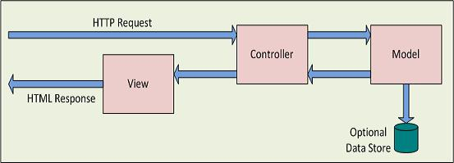
ASP.NET MVC Diagram
http://www.devx.com/webdev/Article/45997

Slide 5
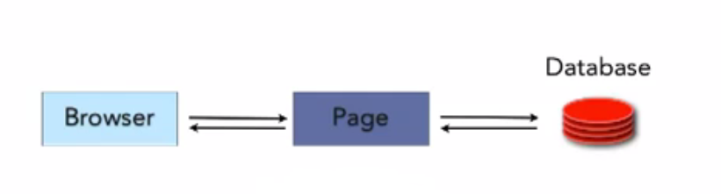
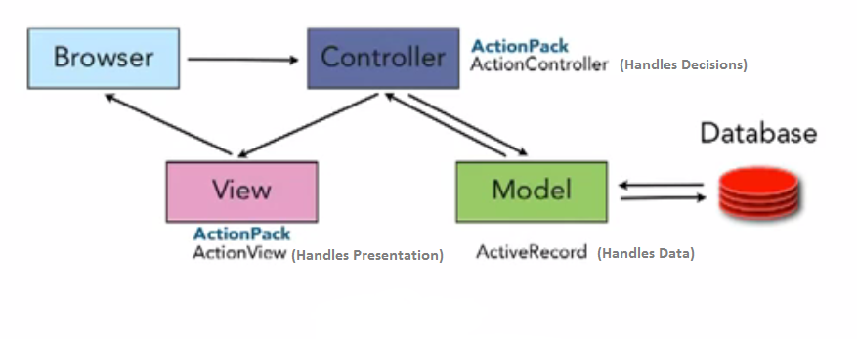
Web Forms vs MVC Architecture
Web Forms
MVC Pattern
http://www.etechpulse.com/2014/01/aspnet-mvc-4-what-is-aspnet-mvcmodel.html

Slide 6
MVC Design
Design of MVC application:
The three approaches are available:
Code-First
DB-First
Model-First: design a model in a designer (MVC 3)
http://msdn.microsoft.com/en-ca/data/gg685494.aspx

Slide 7
Entity Class Product
using System.ComponentModel.DataAnnotations;
public class Product
{
[ScaffoldColumn(false)]
public int ProductID { get; set; }
[Required, StringLength(100), Display(Name = "Name")]
public string ProductName { get; set; }
[Required, StringLength(10000), Display(Name = "Product Description"), DataType(DataType.MultilineText)]
public string Description { get; set; }
public string ImagePath { get; set; }
[Display(Name = "Price")]
public double? UnitPrice { get; set; }
public int? CategoryID { get; set; }
// virtual property for the product
public virtual Category Category { get; set; }
}
}

Slide 8
Primary Key
Note that in our code, we did not include the product or category ID
In the model, when you name a field with the name of the class and ID (e.g., ProductID) it will be automatically set as the primary key and if it is an integer type it will be auto generated

Slide 9
EF – Plural and Singular Table Names
By default, in the case of code-first Entity Framework names of tables in the database are pluralised when created
This setting is optional
Solution: in the context class override OnModelCreating method:
using System.Data.Entity.ModelConfiguration.Conventions;
protected override void OnModelCreating(DbModelBuilder modelBuilder)
{ modelBuilder.Conventions.Remove<PluralizingTableNameConvention>();
}

Slide 10
Many to Many Relationships
Consider a relationship students-courses
You need a junction table to connect the 2 tables: class e.g., CourseRegistration
Add the 2 new models
Include the correct navigation properties
Update the context class and the initializer class
Create the controllers
Add the navigation links
Build the solution
Enable migrations

Slide 11
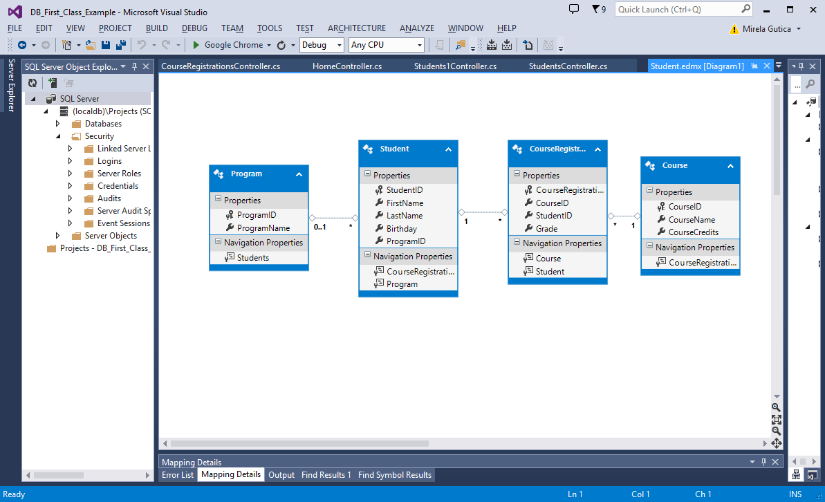

Slide 12
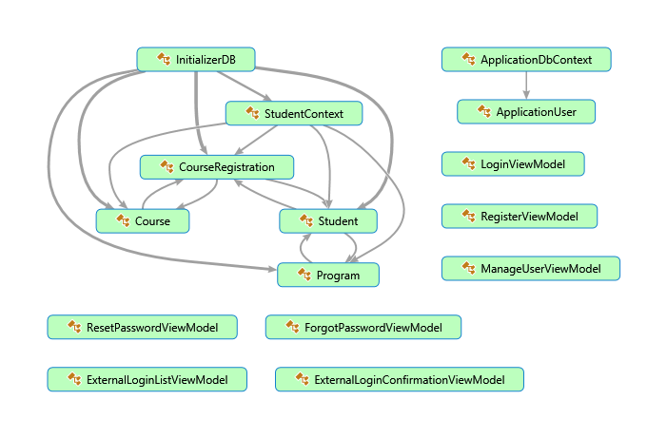
Code Map

Slide 13
Database-First Approach
(1) Create a DB (e.g., using the SQL Server Explorer) or using an existing DB
If an existing DB – include in project
(2) Add a model: Add New item to the Model folder, select Data and ADO.NET Entity Data Model
Choose: Generate from the database
(3) Provide the connection string
(4) Follow the wizard and provide the desired tables
(5) The Entity Container Name indicates the Data context class

Slide 14
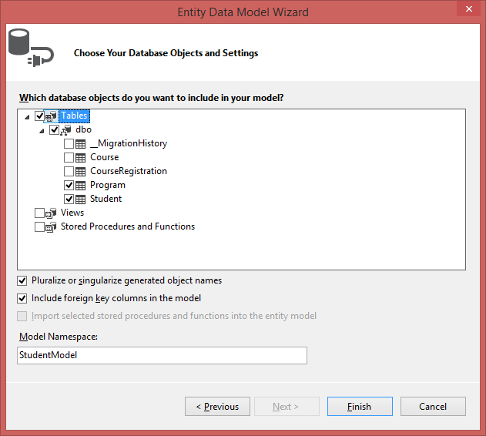
Database Objects

Slide 15
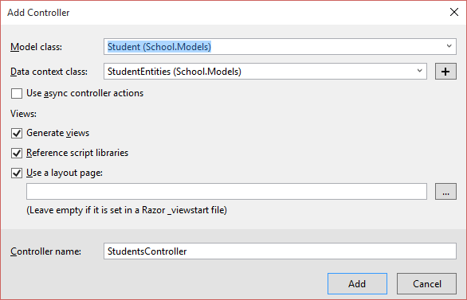
Database-First Approach (2)
(6) Add controllers
MVC Controller with views using Entity Framework

Slide 16
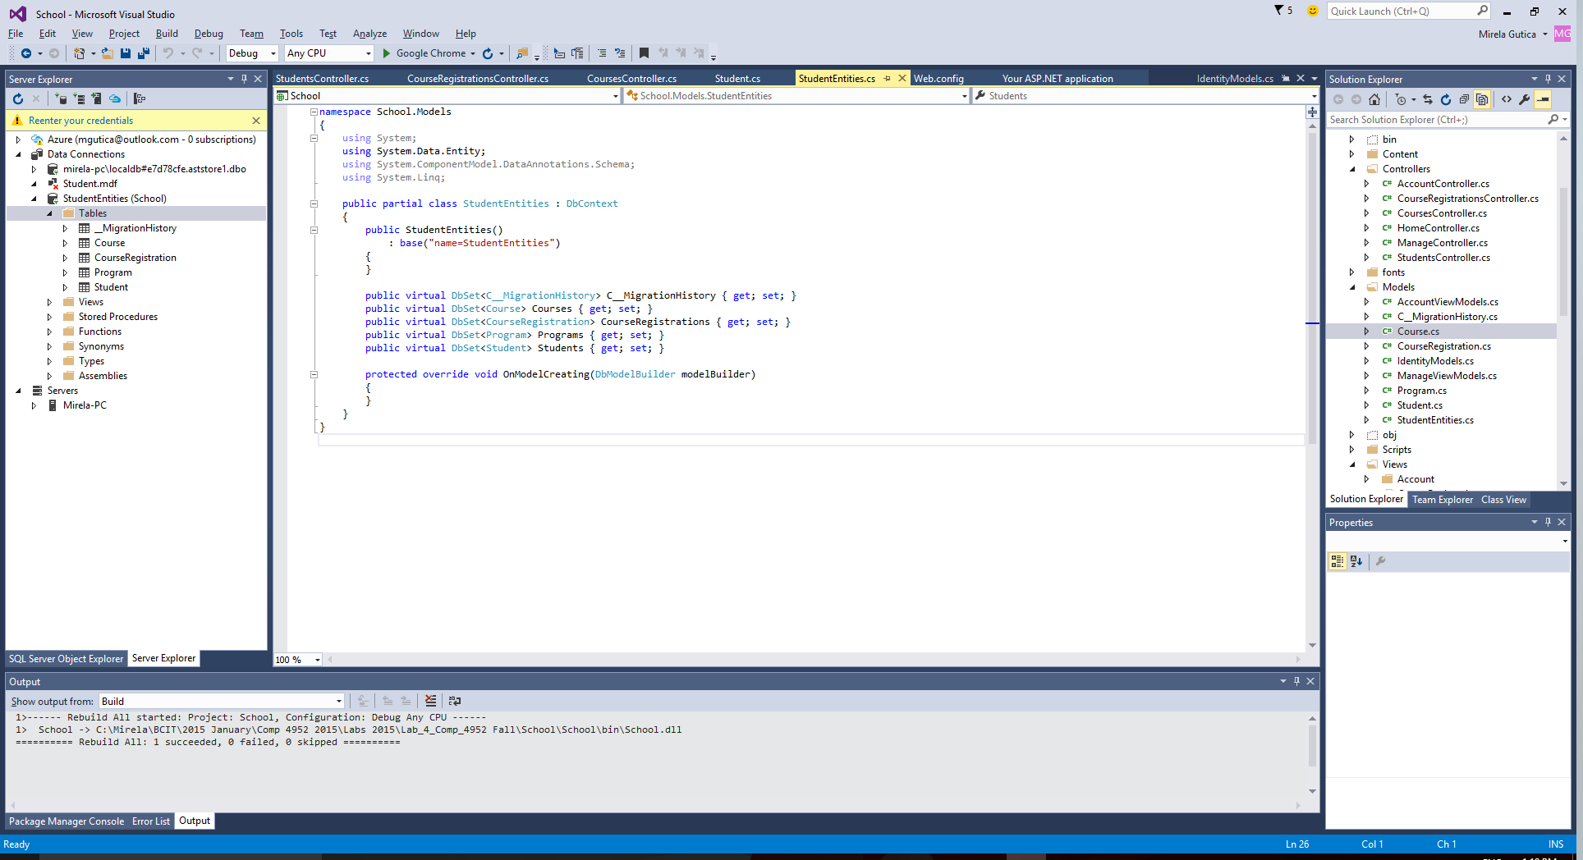
Student Model

Slide 17
Controllers
The class called by URL is the Controller, the Index method
If no controller is specified, the Home Controller is called
public class HomeController : Controller
{
public ActionResult Index()
{
return View();
}
public ActionResult About()
{
ViewBag.Message = "Your application description page.";
return View();
}
public ActionResult Contact()
{
ViewBag.Message = "Your contact page.";
return View();
}
}

Slide 18
RouteConfig
See the RouteConfig.cs in App_Start
The MapRoute indicates the URL configuration
Please note: "{controller}/{action}/{id}"
public static void RegisterRoutes(RouteCollection routes)
{
routes.IgnoreRoute("{resource}.axd/{*pathInfo}");
routes.MapRoute(
name: "Default",
url: "{controller}/{action}/{id}",
defaults: new { controller = "Home", action = "Index", id = UrlParameter.Optional }
);
}
}

Slide 19
RouteConfig (2)
url: "{controller}/{action}/{id}",
Indicates that the request for an action is associated to a specific parameter
E.g., “Create” has the parameter 1, “Delete” 2, etc.

Slide 20
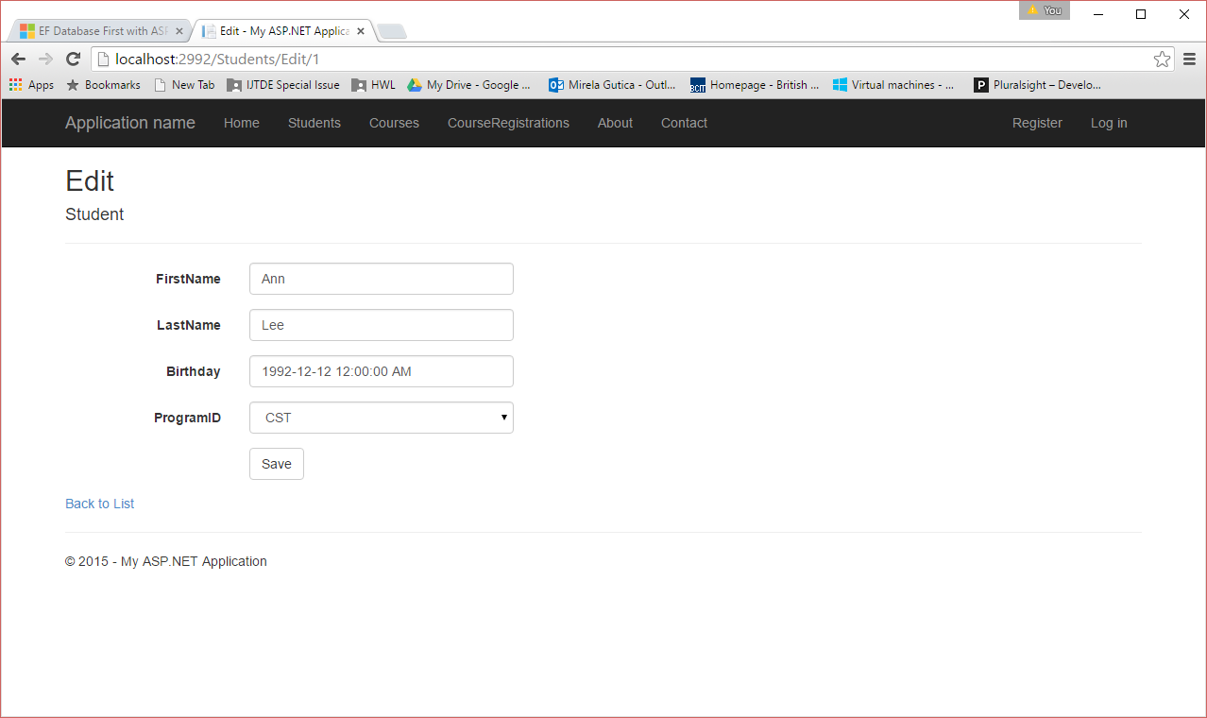
URL
URL indicates: the controller, the action method, the ID

Slide 21
Views
Created automatically when the controller is created
Create them by right click on the desired action method
Create them by right click on the controller
Generally action methods return View()

Slide 22
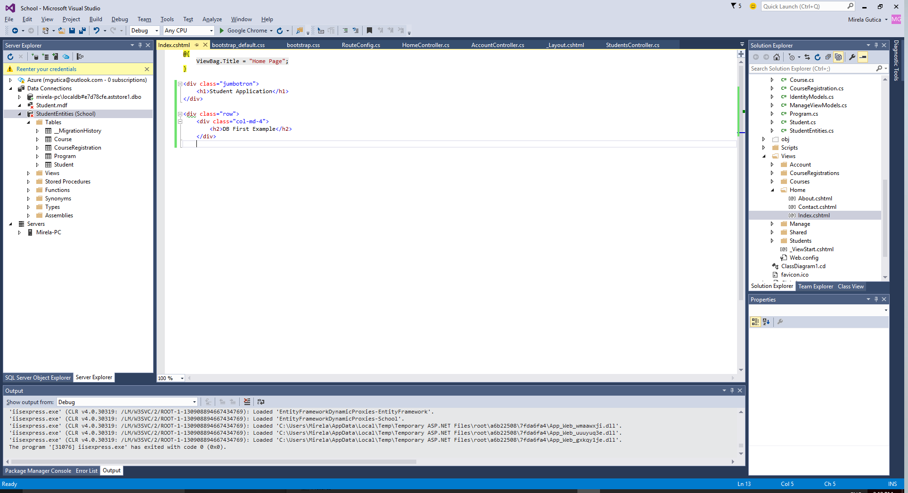
The Home Page View

Slide 23
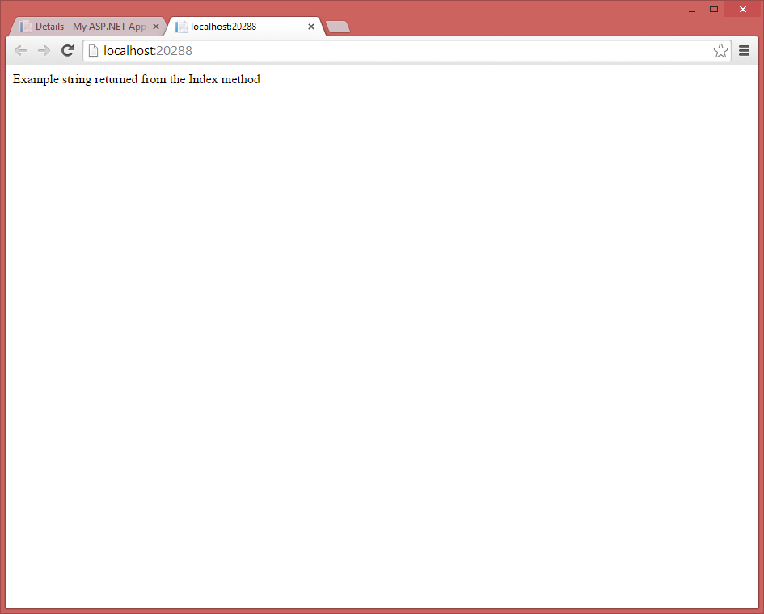
Example: Returning a String
public class HomeController : Controller
{
//public ActionResult Index()
public string Index()
{
//return View();
return "Example string returned from the Index method";
}

Slide 24
State Management in ASP.NET MVC
HTTP is a stateless protocol
ASP.NET Web Forms use state management to maintain the state
In MVC there is no concept of persistence
It's up to developer to return the data to the view
An important issue in MVC is passing the data from a controller to the view
In MVC, data persist in a database where it will be available for future GET requests

Slide 25
What is the problem with session management in MVC?
No ViewState
In ASP.NET the ViewState is a property of the Page used to populate controls
Controls belonging to the Page need to store some data inside ViewState
The ViewState mixes the business logic with the view
It exists in ASP.NET MVC and works well for some controls (not all) if you decide to use server-side controls in your MVC code you can; but violates the separation of concerns rules

Slide 26
Session Objects ?
ASP.NET MVC supports the Session object (however, not recommended)
Create a model that holds the properties representing the session variables: SessionModel
Create a controller that has an ActionResult method that returns the session data

Slide 27
Models
Data Models (basic classes)
Business Models (business logic)
View Models

Slide 28
Passing Data to the View (1)
Model: - the best way to pass data between the Controller and the View:
Model: Declare the class
Controller: Initialize/update the model data
View: Extract the data from the Model:
<div class="editor-label">
@Html.LabelFor(model => model.LastName)
</div>
<div class="display-field">
@Html.DisplayFor(model => model.LastName)
</div>

Slide 29
Passing Data to the View (2)
The following code is auto generated; however you can write your own code
private StudentContext db = new StudentContext();
// GET: Students
public ActionResult Index()
{
var students = db.Students.Include(s => s.Program);
return View(students.ToList());
}

Slide 30
Passing Data to The View (3)
In the View it is indicated what objects are passed (student or list of students) and what model class is used
“@model” used to specify the type of object:
@model <MVC_Code_First.Models.Student>
@model IEnumerable<MVC_Code_First.Models.Student>
“@Model” used to specify the use of the object:
<h2>Program Name :@Model.program.ProgramName</h2>
@foreach (var item in Model) {
<tr>
<td>
@Html.DisplayFor(modelItem => item.Program.ProgramName)
</td>
<td>
</tr>

Slide 31
Passing Data to the View - ViewPage
ViewPage class allows rendering data in the View (even if a Model exists) without reading from the database
represents the properties and methods that are needed to render a view as a Web Forms page
Properties of ViewPage are used for passing data from controller to view:
ViewData
A dictionary that contains data to pass between the controller and the view
ViewBag
A dynamic property to pass to the view
TempData
Also a dictionary; temporary data to pass to the view
The data stored in the TempData property persists for only one request
Readings:
http://msdn.microsoft.com/en-us/library/system.web.mvc.viewpage(v=vs.118).aspx

Slide 32
ViewData
public ViewDataDictionary ViewData { get; set; }
Passing data from a controller to a view:
add data to the controller's ViewData property in the action method that renders the view:
ViewData[“school"] = “BCIT";
Passing data from the view to a controller:
add data to the ViewData property of the view:
<% ViewData[“school"] = schoolName %>
Type:
System.Web.Mvc.ViewDataDictionary

Slide 33
Thread Safety
Important:
Any public static members of DataView type are thread safe
Any instance members are not guaranteed to be thread safe
Similar to the HttpContext class

Slide 34
ViewBag
ViewBag
Dynamic object that provides a convenient late-bound way to pass information from a controller to a view
It is an object easy to use; however internally it is still using ViewData
public Object ViewBag { get; }
@{
ViewBag.Title = "About";
}
<h2>@ViewBag.Title.</h2>
<h3>@ViewBag.Message</h3>

Slide 35
TempData
Gets the temporary data to pass to the view
public TempDataDictionary TempData { get; }
Important:
The data stored in the TempData property persists for only one request

Slide 36
ViewPage Issues
Using the ViewPage properties to pass data between the Controller and the View works well for small projects
Easy to use
No compile-time checking –use unit tests!
If a property is removed from the ViewBag the View will not know!
No code navigation
Too much code – difficult to read
ViewData has the same issues as the Session object: you have to use a static class for the variables held in the ViewData

Slide 37
Passing More Complex Data to the View
The data model is passed to the View in the Controller action method:
public ActionResult Index()
{
var students = db.Students.Include(s => s.Program);
return View(students.ToList());
}
More properties?
Use the ViewData/ViewBag
However, this will make the code hard to read
Robust solution: separate your data into data model, business model and ViewModel
Partial classes?
Classes with extra properties to expose in various views
Code is hard to read and maintain!

Slide 38
Passing Data to the View: Multiple Objects
In a controller’s action method, you can pass to the view only one object or a list of objects
You cannot pass multiple objects
Solution: ViewModels
ViewModel: A modality to explicit declare data from different models for a single view

Slide 39
ViewModel (1)
Views that allow to be displayed objects from multiple classes (models)
namespace MVC_Code_First.ViewModels
{
public class StudentsInProgram
{
public List<Program> allPrograms { get; set; }
public List<Student> allStudents { get; set; } }
}

Slide 40
ViewModel (2)
Allows to:
Combine data from different models
Display in the View data from a model and some other properties
Display only some of the properties of a specific model
Easy and proper formatting of data in the view

Slide 41
Exercise (1)
Consider a solution two models Student and Program
Display on the same view all students in this school
The user can select a program from a list box which will generate the list of students in that particular program
Solve the problem with a ViewModel

Slide 42
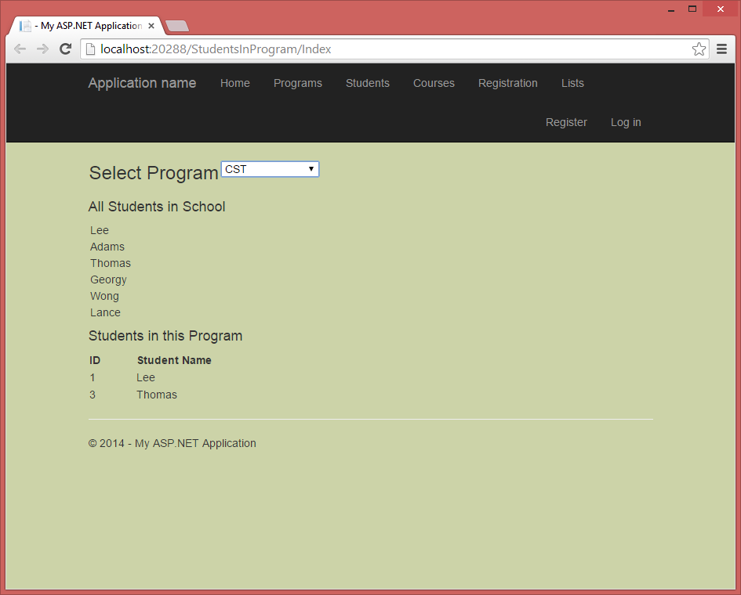
Exercise (2)

Slide 43
Add a ViewModel
Create the models (or use exiting models)
Create a new folder ViewModels
Create the new ViewModel class
Create a controller (no scaffolding)
Write the action methods
Create views for action methods

